Slide 1

Lintouch Architecture
Martin Man <mman@lintouch.org>
June 2004

Slide 2
Agenda
Parts of the Lintouch System
  Server, Runtime, Editor
  Project
Connecting to the Real World
  Plugins HOWTO
Visualizing the data
  Templates HOWTO

Slide 3
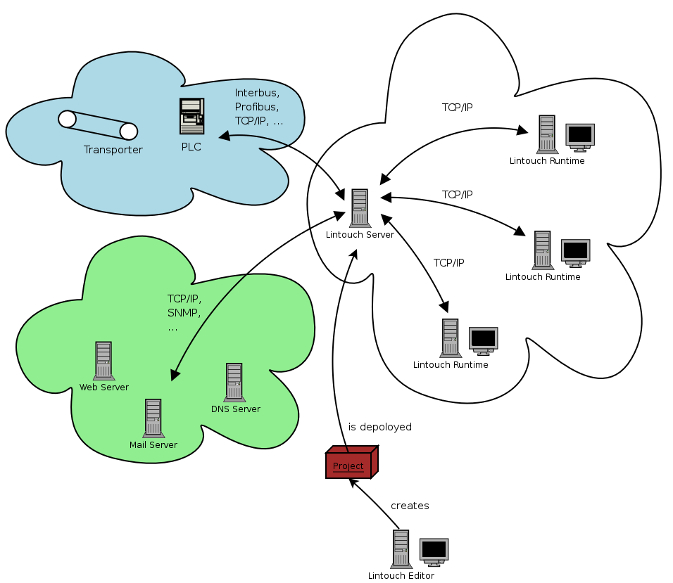
Parts of the Lintouch System

Slide 4
Lintouch Server
Inputs
  Project (will be described later)
Outputs
  Data from monitored systems
Role
  To read/write data from/to a monitored system and make them available as a set of typed variables (BIT, NUMBER, STRING)
  output to a network only, no screen needed

Slide 5
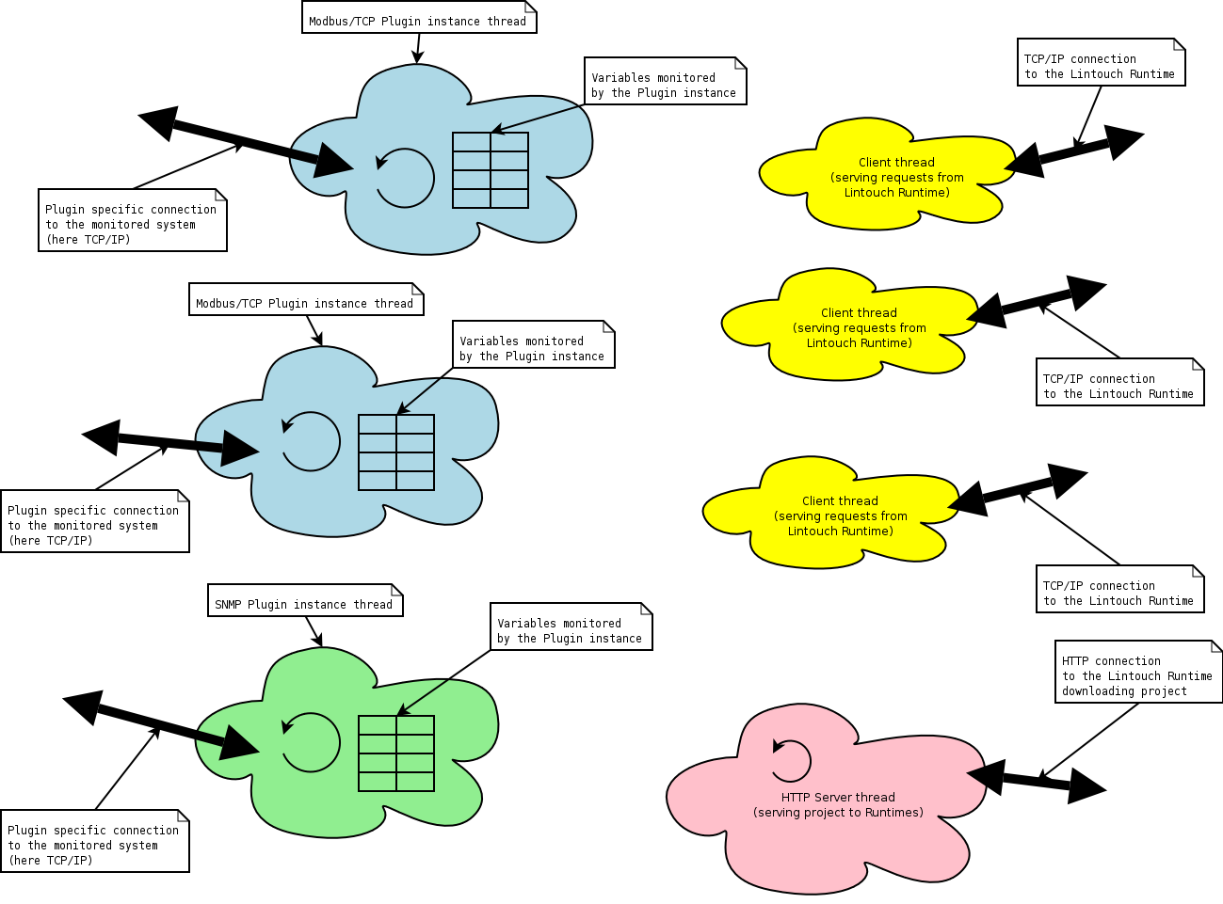
Lintouch Server (cont.)

Slide 6
Lintouch Runtime
Input
  Lintouch Server TCP/IP address and port
Output
  System visualized according to the project
Role
  To visualize data obtained from the monitored system
  To control the monitored system in a limited manner (not a PLC)

Slide 7
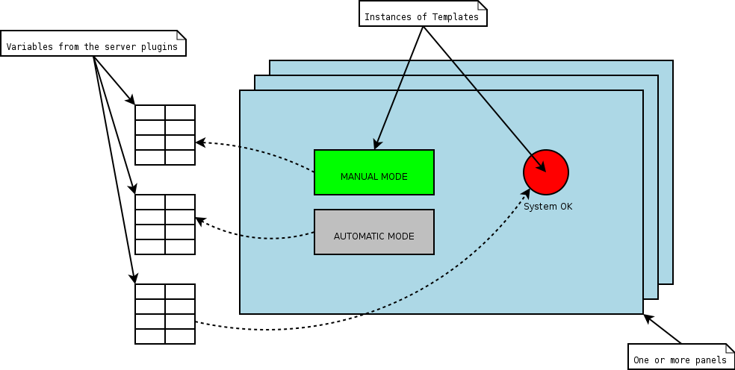
Runtime (cont.)

Slide 8
Lintouch Editor
Inputs
  connection descriptors (configuration files for plugins)
  template libraries (containing templates)
Outputs
  Project ready to be deployed at the Server
Role
  To create visual representation of the monitored system

Slide 9
Lintouch Project
.zip file with well defined structure
must have project-descriptor.xml
might include one or more
  connection descriptors
  view descriptors
  template libraries
might include resources and localizable strings (resources/ subdirectory)

Slide 10
Project Descriptor
General Info
  Author, Version, ...
Template Libraries
  Where to look for templates
Views
  How to visualize
Connections
  How to access data
General Info
  Author, Version, ...
Template Libraries
  Where to look for templates
Views
  How to visualize
Connections
  How to access data
<?xml version="1.0" encoding="utf-8"?>
<project>
<project-info>
<author>Martin Man &lt;mman@swac.cz&gt;</author>
<version>1.0</version>
<date>2004-02-25</date>
<shortdesc>short_desc</shortdesc>
<longdesc>long_desc</longdesc>
</project-info>
<project-views>
<view name="default" src="view-default.xml"/>
</project-views>
<project-template-libraries>
<template-library name="mytemplatelibrary"/>
</project-template-libraries>
<project-connections>
<connection name="bit-loop" src="connection-bit-loop.xml"/>
<connection name="bit-gen" src="connection-bit-gen.xml"/>
</project-connections>
</project>

Slide 11
Connection Descriptor
<?xml version="1.0" encoding="utf-8"?>
<project-connection type="Hilscher">
<properties>
<property name="refresh" value="0.1"/>
<property name="outputoffset" value="8"/>
<property name="inputoffset" value="8"/>
<property name="inputbytelen" value="20"/>
<property name="outputbytelen" value="20"/>
</properties>
<variables>
<variable name="A 8.0" type="bit"/>
<variable name="A 8.1" type="bit"/>
<variable name="A 8.2" type="bit"/>
<variable name="A 8.3" type="bit"/>
<variable name="A 8.4" type="bit"/>
<variable name="A 8.5" type="bit"/>
<variable name="A 8.6" type="bit"/>
<variable name="A 8.7" type="bit"/>
<variable name="E 8.0" type="bit"/>
<variable name="E 8.1" type="bit"/>
<variable name="E 8.2" type="bit"/>
<variable name="E 8.3" type="bit"/>
<variable name="E 8.4" type="bit"/>
<variable name="E 8.5" type="bit"/>
<variable name="E 8.6" type="bit"/>
<variable name="E 8.7" type="bit"/>
</variables>
</project-connection>
Configuration for a Plugin
Connection type
  Modbus, Hilscher
Properties
  IP address, port (optional)
Variables
  name, type
  properties (optional)

Slide 12
View Descriptor
<?xml version="1.0" encoding="utf-8"?>
<project-view>
<geometry width="1024" height="768"/>
<panels>
<panel id="01/Rollenbahn">
<templates>
<template name="LL" type="Lamp">
<geometry height="90" layer="1"
left="133" top="654" width="101"/>
<property name="skin" value="rectangle"/>
<property name="border_off"
value="#BFBFBF;1;SOLIDLINE"/>
<property name="fill_off"
value="#BFBFBF;SOLIDPATTERN"/>
<iopin name=”input”>
<bind-to-variable connection=”rollenbahn”
variable=”A 8.0”/>
</iopin>
</template>
</templates>
</panel>
</panels>
</project-view>
Dimmensions
  Virtual coordinate system
One or more Panels
One or more Templates
  Geometry within the coordinate system
  Properties
    fonts, colors, texts
  Variable Bindings
    whre to get data from

Slide 13
Connecting to the real world
What defines a variable
  Name
    unique within a connection
  Type
    bit, number, string
  REAL VALUE
    bus to the server plugin, server to the runtime
  REQUESTED VALUE
    runtime to the server, server plugin to the bus

Slide 14
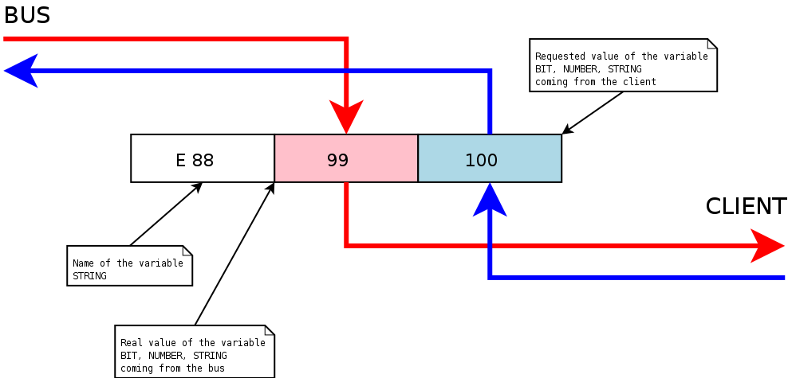
Variable in detail

Slide 15
Writing a Server Plugin
What is a Plugin
  Python class derived from wtng.server.ServerPlugin
Methods to be reimplemented
  __init__
    variables, conn_config, variables_config
  run
    never ending loop working with variables
  stop
    signal a request for termination

Slide 16
Example Plugin (Loopback)
from wtng.server.ServerPlugin import ServerPlugin
class LoopbackPlugin(ServerPlugin):
def __init__(self, varset, global_config, vars_config):
ServerPlugin.__init__(self, varset, global_config,
vars_config)
# remember variable names
self.allvariables = vars_config.keys()
self.terminated = False
def run(self):
while not self.terminated:
self.varset.lock_requested()
# wait for new requested values from any client for 1 second
while not self.varset.wait_for_new_requested_values(1000000) and not self.terminated:
self.varset.unlock_requested()
self.varset.lock_requested()
# loop all dirty received values back
for varname in self.allvariables:
if self.varset[varname].is_requested_value_dirty():
self.varset[varname].set_real_value(
self.varset[varname].requested_value())
# clear dirty flags
self.varset.sync_requested()
self.varset.unlock_requested()
# send back to the clients
self.varset.sync_real()
def stop(self):
self.terminated = True

Slide 17
Visualizing the data
Defining a template
  how will template interact with the monitored system
    iopins, their names and types
  what will template look like, what can be customized
    properties and their types
  how will template interact with the user
    handling mouse/keyboard events

Slide 18
Writing a Template
What is a Template
  C++ class derived from swac::wtng::Template
Methods to be reimplemented
  constructor
    to create iopins and properties
  propertiesChanged()
    template was placed on a panel
  drawShape() callback
    to paint the template

Slide 19
Writing a Template (cont.)
Methods to be reimplemented (cont.)
  iopinsChanged()
    monitored system has changed
  mousePressed(), mouseReleased(), ...
    user interacting with a template

Slide 20
Questions?
  Thank You for your time...

